Slide 1
GOODS MARKET EQUILIBRIUM
The Derivation of the IS Curve
By:
Dr. Papinder Bhagat
Assistant Professor in Economics
Govt. Degree College, Basohli

Slide 2
The Derivation of the IS Curve
The goods market is in equilibrium when aggregate demand (C+I) is equal to income (Y) and planed Investment (I) is equal to planned saving (S) which mean equilibrium in Product market Requires.
Y=C+1
S = I
Equilibrium between S = I is influenced by consumption, saving and investment function.

Slide 3
Following equations explains goods market equilibrium:
Consumption function C=C(Y)
Investment function I = I(r)
Equilibrium situation is Y = C(Y) +I(r)
From saving investment approach, following equilibrium is obtained at
Saving function S = S (Y)
Investment function I = I(r)
Equilibrium situation is S (Y) = I(r)
These sets of equations have been graphically presented in below figure.

Slide 4
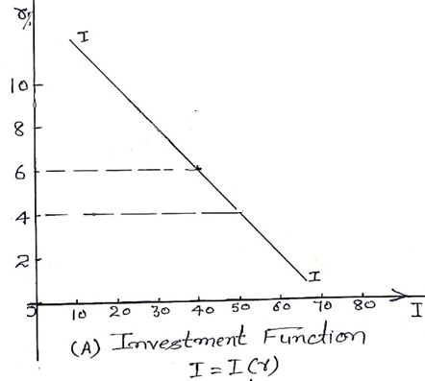
Before explaining the whole figure, it necessary to explain each part separately
Part A provides investment spending schedule. It indicates that investment spending is a negative function of rate of interest. If rate of interest rises, investment falls and vice versa.

Slide 5
Part B shows planned investment is equal to planned savings which is expressed by 45˚angle line starting from the point of origin. Planned investment is measured along X-axis and planed saving along Y-axis.

Slide 6
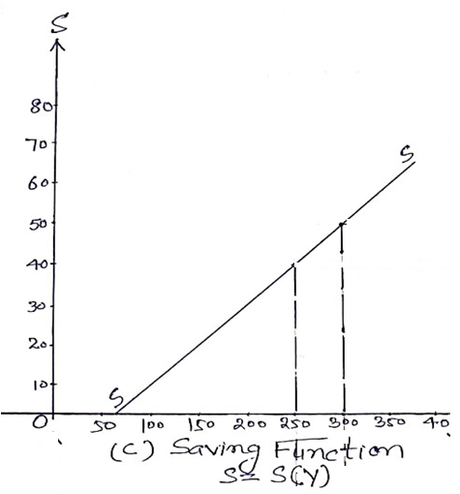
Part C showing saving function that savings varies directly with income

Slide 7
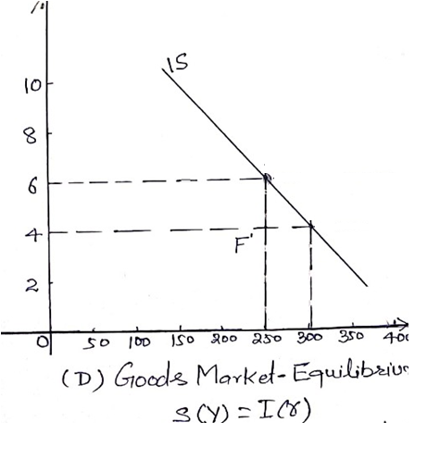
Part D showing IS curve i.e. goods market equilibrium.

Slide 8
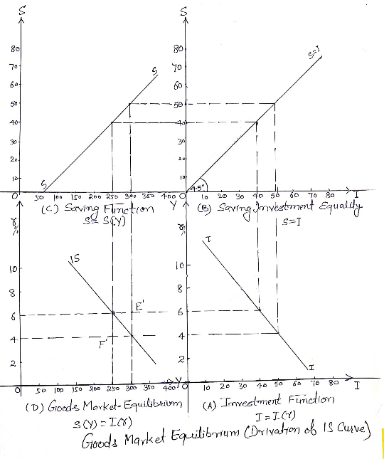
Derivation of IS Curve

Slide 9
Let us consider that interest rate is 6% in Part A of the figure. It shows investment is Rs. 40 per unit. In part B to justify equality between S and I, saving should be equal to Rs. 40 as shown along Y-axis. In part C saving will be Rs. 40 only at the level of income Rs. 250. Thereafter, bringing together Y of Rs. 250 from part C and R of 6% from part A yield one combination of Y and r at which S=I.

Slide 10
Let us consider linear rat of interest 4 % then investment in Part A will increase to Rs. 50 which yield an income level of Rs. 300 in part C. Therefore, Y of Rs. 300 and r of 4% is another combination of IS curve. Likewise, we can trace out other combinations also. If we connect all these point we get IS curve.

Slide 11
There is not as single level of income at which S= I but separate level for each separate rate of interest rate. Higher will be the r, lower will be income level at which S=I. It implies that higher r signifies low I. Lower I through multiplier effect means a low Y. Alternatively low Y means low S. Goods market requires S=I. Low S means low I. A low I is because of higher r. Every combination on IS curve are equally possible equilibrium combination of Y and r in goods market.

Slide 12
Identifying every equilibrium combination does not imply that actual combination in every period will be one and same. There may be disequilibrium in products market.
Let us consider actual combination of Y Rs. 300 and r is 6% as shown by point E’ in part D of the figure. At the level of income Rs. 300. S will equal to I only at the rate of interest 4%. Given income level of Rs. 300 signifies at an rate of interest 4%, S must exceed I as I will be smaller at higher than 4% rate of interest but S will be unchanged S depend on Y which remains unchanged of Rs. 300.

Slide 13
Combination of Y=300 and r=6% is also disequilibrium from another angle that is at r=6%, S will equal to I only at an income level of Rs. 250. So at available combination of Y &r ( at point E’) S must be greater than I as S will be more at the income level of Rs 300, but I will remain same. I depends on r which is here unchanged at 6%.Any point on right of IS curve shows disequilibrium i.e S is more than I and Y is more than C+I.
Similarly, any point on left of IS curve also shows disequilibrium where I>S and C+I >Y. Alternately, aggregate spending on the product is more than aggregate output of the goods.

Slide 14
Thanks….

